Slide 1
Winning the Budget Showdown
Nov. 15, 2012

Slide 2
PROBLEM: REVENUES DON’T MATCH EXPENSES
~5.5%
~3%
Average
Note: Data from CBO, 2012 – 2022 from CBO Alternative Fiscal Scenario
Historic recessions per NBER
* Historical average for 1972 - 2011, per CBO

Slide 3
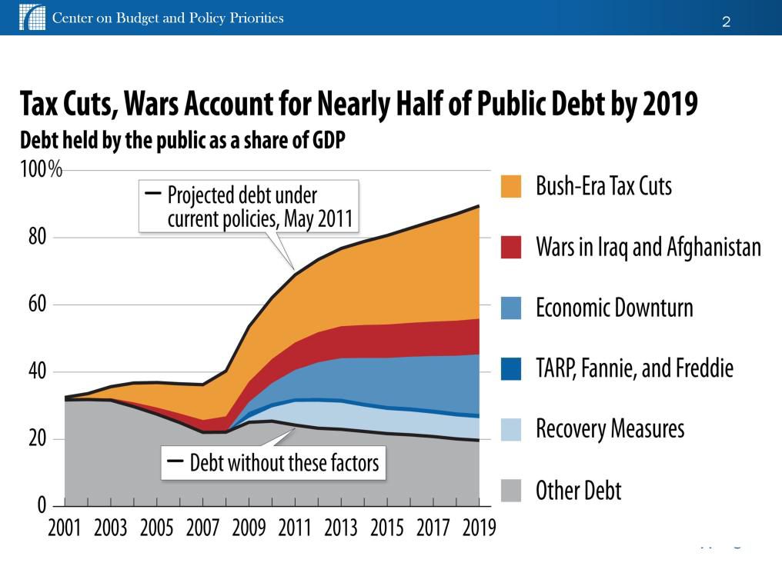
TAX CUTS CAUSE DEFICITS

Slide 5
FISCAL SHOWDOWN DATES
Nov. 13: Congress begins lame-duck session that lasts until Christmas
Dec. 31: Bush-era tax cuts expire for all Americans
Jan. 2, 2013: $109 billion in across-the-board spending cuts known as sequestration begin
March: Debt ceiling will need to be raised again
Ongoing: “Grand Bargain” budget negotiations

Slide 6
KEY ISSUES
Cancel $1.2 trillion cuts over 10 years: across-the-board budget cuts (aka “sequestration”)
Establish a framework for larger deficit reductions: up to $4 trillion over 10 years, including $1.5 trillion cuts made in 2011
Raise $1 trillion by ending Bush tax cuts for richest 2%: Renew Bush tax cuts for other 98%
Raise additional progressive revenue: get at least 50-50 split of revenue to cuts for $4 trillion

Slide 7
SEQUESTRATION CUTS
$1.2 trillion cut over 10 years: 50-50 split defense and non-defense
$109 billion cut in 2013: $55 billion in defense & non-defense
Job Loss: 1-2 million
Exempt from cuts: Social Security, Medicare benefits, Medicaid, SNAP, veterans programs
Cuts:
10% in grants to states and localities
$4 billion in education: Title 1, special education, Head Start
Health: senior nutrition, Maternal & Child Health, immunizations

Slide 10
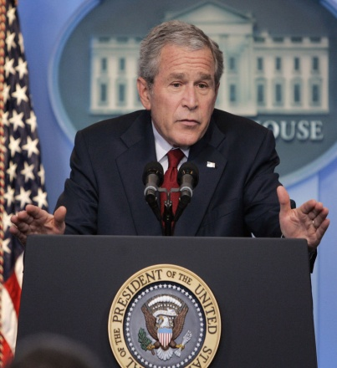
BUSH TAX CUTS
Obama position: Extend Bush tax cuts for 98% of Americans; end them for top 2% (households making $250,000+ a year)
Worth $1 trillion over 10 years
25% of $4 trillion deficit-reduction goal
Equals $1 trillion in budget sequestration (defense & domestic)
Ending Bush tax cuts on richest 2% means:
Return to higher income tax rates at top end: 35% to 39.6%
Higher capital gains tax (rising from 15% to 20%) and higher tax on dividends (rising from 15% to ordinary income tax rate)
Higher estate tax:
Exempt $7 million not $10 million estates; tax at 45%, not 35%
Affects 3 out of 1,000 families

Slide 11
BUSH TAX CUTS MESSAGE
Core message: End the Bush tax cuts for the richest 2%. It’s time for the wealthiest Americans and big corporations to pay their fair share of taxes.
Connect: Our tax system is rigged in favor of the wealthy and big corporations and isn’t working for most Americans.
Values: We applaud financial success, but when the rich get special tax breaks they don’t need and the country can’t afford the middle class has to make up the difference.
Illustrate: The Bush tax cuts give a $160,000 tax break on average to someone who makes $1 million a year.
Bottom Line: Politicians stacking the deck in favor of their wealthy campaign contributors and sticking the rest of us with the tab is not right. It’s time the wealthy played by the same rules and paid their fair share.

Slide 12
2012 ELECTION LESSONS
Middle class won
Tax fairness won: By 60% to 35% voters said end Bush tax cuts for those who make $250,000 or more
Winning Democrats made tax fairness a core issue
Democrats are beating Republicans on tax issue
Opportunity to go on offense

Slide 13
HOW TO WORK TOGETHER
Work with Americans for Tax Fairness coalition in your state: Participate in press conferences, forums
Messaging: Use ATF polling and tax message materials
Organize: An elected officials sign-on letter to the state congressional delegation
Lobby: Personally lobby your members of Congress
Sign an op-ed: We can help draft it

Slide 14
ATF COALITION
225 national and state organizations and growing
Labor: AFL-CIO, AFSCME, NEA, SEIU, UAW and more
Think Tanks: Center on Budget & Policy Priorities, Center for American Progress, Citizens for Tax Justice, Economic Policy Institute
Field Groups/Netroots: MoveOn.org, USAction, Working America
Women’s Groups: NOW, National Women’s Law Center, AAUW
Human Needs Groups: Coalition on Human Needs, The Arc, Children’s Defense Fund
Civil Rights Groups: Leadership Conference on Civil and Human Rights, National Council of La Raza
Small Business Groups

Slide 15
CONTACT US
Robert Brandon, Consultant, 202-331-1550 rmbrand@robertbrandon.com
Campaign Manager: Frank Clemente fclemente@americansfortaxfairness.org
Field Director: Shelli Craver scraver@americansfortaxfairness.org
www.americansfortaxfairness.org
@4taxfairness
Americans4TaxFairness

