Slide 1
THE CENTRAL ROLE OF TAXES IN
CREATING AN ECONOMY THAT
WORKS FOR ALL OF US

Slide 2
JOHN ANZALONE
ALG Research
Notes:
Source: ATF fact sheet JOE BIDEN’S TAX PLAN
https://americansfortaxfairness.org/issue/joe-bidens-tax-plan/

Slide 3
THE OPPORTUNITY:
BIDEN’S TAX FAIRNESS MANDATE

Slide 4
THE BIDEN ELECTION MANDATE
Biden prevailed with a major progressive tax fairness message and plan. It got considerable media attention and was heavily attacked by his opponents.
— Most progressive tax & public investment plans of any prez candidate in modern history
Biden’s stump speech in the closing weeks of the campaign was built around an aggressive call for making the wealthy and corporations pay their fair share.
Republican ads prominently featured tax issues and mostly attacked Biden’s tax plan.
— From mid-July to late October taxes were often at or near the top among the issues most frequently mentioned in broadcast ads for Trump – many strongly criticizing Biden’s plan
— Between Labor Day and Election Day, taxes were among the top 5 most frequently mentioned issues in broadcast ads for Joe Biden, many defending his tax plan.
Notes:
For additional information go to ATF fact sheet BIDEN-HARRIS WIN A TAX FAIRNESS MANDATE
https://americansfortaxfairness.org/issue/biden-harris-win-tax-fairness-mandate/

Slide 5
BIDEN’S ELECTION MANDATE: POLLING
“As pollsters for President Biden’s campaign in both the primary and general election, we found that few issues generated broader, more intense support than raising taxes on those earning over $400,000 a year and closing tax loopholes for big corporations. The issue of tax fairness was therefore a core part of the Biden campaign’s messaging in both its advertising and in the candidate’s stump speech. The campaign’s focus on Biden’s plan to raise taxes on those making over $400,000 – but not on anyone making less than that – not only allowed it to rebut Republican claims that President Biden would raise taxes on the middle class, but also helped give President Biden a critical advantage on which candidate was seen as more likely to help working families.”
John Anzalone, ALG Research memo, Feb. 15, 2021
Notes:
For full ALG Research memo go to
https://americansfortaxfairness.org/issue/biden-2020-pollster-highlighting-tax-fairness-can-provide-major-benefits-democrats/

Slide 6
BIDEN’S ELECTION MANDATE: POLLING
“Proposals to raise taxes on the wealthy were the most popular of more than 30 economic proposals tested by ALG Research in 2020.”
“Whether paired with closing tax loopholes for big corporations or using the money to invest in priorities like lowering healthcare costs, improving education, and strengthening Social Security and Medicare, proposals on raising taxes on the wealthy outperformed all other economic proposals tested in our 2020 polling among both Independents and voters overall.”
“Democrats should go on offense with their plans to raise taxes on those earning over $400,000 and closing corporate tax loopholes.”
John Anzalone, ALG Research memo, Feb. 15, 2021
Notes:
For full ALG Research memo go to
https://americansfortaxfairness.org/issue/biden-2020-pollster-highlighting-tax-fairness-can-provide-major-benefits-democrats/

Slide 7
BIDEN’S ELECTION MANDATE: TV ADS
Notes:
Video URL is here:
https://www.youtube.com/watch?v=tN4dV8jwgAU

Slide 8
BIDEN’S ELECTION MANDATE:
BUILD BACK BETTER
Notes:
Video URL is here:
https://americansfortaxfairness.org/wp-content/uploads/Biden-clip.mp4

Slide 9
FRANK CLEMENTE
Americans for Tax Fairness
Notes:
Source: ATF fact sheet JOE BIDEN’S TAX PLAN
https://americansfortaxfairness.org/issue/joe-bidens-tax-plan/

Slide 10
BIDEN’S BUILD BACK BETTER AGENDA

Slide 11
BIDEN’S AGENDA:
BUILD BACK BETTER INVESTMENTS
$2 Trillion
Rebuild infrastructure & clean energy
$2 Trillion
Major expansions to healthcare access & affordability
$2 Trillion
Childcare, universal
pre-K, free public comm. college, pay down student debt
$650 Billion
Affordable housing for working families
$1 Trillion
Strengthen Social Security & Supplemental Security Income
$500 Billion
Working family tax credits: EITC & CTC
Notes:
The cost of Biden’s investment plans that he proposed during the campaign range from $7 trillion to $11 trillion depending on the source.
Source: ATF fact sheet JOE BIDEN’S BOLD INVESTMENT AGENDA
https://americansfortaxfairness.org/issue/joe-bidens-bold-investment-agenda/

Slide 12
BIDEN’S AGENDA: FAIR SHARE TAXES
Raise $3-4 trillion
Repeal Trump-GOP tax cuts benefiting rich & corporations
Corporate tax rate 21% 28%
Tighten offshore loopholes
Equalize cap gains rate on $1M+ income
End stepped up basis – tax gains at death
28% deductions cap
Restore estate tax to 2009 levels
$1.2 T in Tax Credits
$500B: families & caregivers
$400B: homebuyers, retirement, green energy
$300B domestic manufting, green energy
Notes:
Source: ATF fact sheet JOE BIDEN’S TAX PLAN
https://americansfortaxfairness.org/issue/joe-bidens-tax-plan/

Slide 13
ATF STRATEGY 2021-2022
Ensure Biden proposes tax & investment plans that track his campaign promises
— Down payment of $3-4 trillion (ATF’s 10-year goal: $10 trillion)
Win vote in Congress on his plan in late 2021
— Budget reconciliation rules only require Senate majority vote; no filibuster
Mobilize, Mobilize, Mobilize
— Consolidate progressive community behind the Biden plan
— Determine what moves moderate Democrats to our position
— Robust mobilization and earned media operations in target states
— Show federal revenue is key to addressing state fiscal crises and investment needs
Win message war in 2022 election year

Slide 14
STATES DEPEND A LOT ON
FEDERAL TAX REVENUES
33%
Average share of state budgets funded by federal government
in 2020
Notes:
Source: National Association of State Budget Officers, 2020
See Master Table at https://docs.google.com/spreadsheets/d/14-gDSXvXWW5Jtcp597QTYiHHweCRkuPXGIi4LXYoFRo/edit?usp=sharing
In many states, governments have announced they want to cut taxes.

Slide 15
$4 TRILLION IN NEW FEDERAL REVENUE
States’ Share = $2.5 Trillion
% of State Budget from Federal, 2020
38%
25%
35%
26%
44%
30%
36%
38%
34%
25%
$ Billions Each Year
for 10 Years
$42
$3.5
$11
$5.4
$9.0
$4.5
$21
$7.6
$15.0
$4.4
% of State
Spending in 2020
13%
9%
12%
9%
15%
10%
12%
13%
12%
8%
CALIFORNIA
COLORADO
FLORIDA
MASSACHUSETTS
MICHIGAN
MINNESOTA
NEW YORK
NORTH CAROLINA
TEXAS
WISCONSIN
Notes:
ATF calculations are at this spreadsheet – see $4 Trillion Table.
https://docs.google.com/spreadsheets/d/14-gDSXvXWW5Jtcp597QTYiHHweCRkuPXGIi4LXYoFRo/edit?usp=sharing
Calculations are based on a 2020 federal budget of $4.8 trillion of which $3.5 trillion was spent on programs that do not fund state and local governments:
$1.155 trillion for Social Security, $843 billion for Medicare, $690 billion for the military, $576 billon for interest on the debt and $214 billion for veterans’ affairs.
https://www.thebalance.com/fy-2020-federal-budget-summary-of-revenue-and-spending-4797868
$1.3 trillion remains after subtracting the $3.5 trillion cost of those programs. Federal funds to states amounted to about $733 billion in 2020, or about 56% of the $1.3 trillion total. 56% of $4 trillion in new revenue (roughly what had been proposed by candidate Joe Biden) that is not allocated to the excluded programs above equals $2.5 trillion divided among the states over 10 years.
State revenue shortfall estimates are from media stories.

Slide 16
ATF & MOVEMENT FUNDING PRIORITIES
Influence Moderate Democrats
On tax and investment issues
Communications
Polling/Messaging
More robust communications (media and digital) especially in target states
Deepen Coalition Work
Get advocacy and movement groups to “own” the tax issue and align messaging and strategies
Field Mobilization
Significantly strengthen field capacity for federal and state revenue fights
Elections
Make tax fairness a major issue in elections and in the ongoing dialogue on the nation’s economic priorities

Slide 17
LOBBYING PRIORITIES
Senate Moderates:
AZ: Sinema & Kelly NH: Shaheen & Hassan (SFC)
CO: Bennet (SFC) and Hickenlooper NV: Cortez-Masto (SFC) & Rosen
ME: King VA: Warner (SFC & Budget), Kaine (Budget)
MT: Tester WV: Manchin
House Moderates: Problem Solvers Caucus, Blue Dog Coalition, New Democrats
Organize a table of national groups to coordinate state-based mobilization and communications work

Slide 18
MARGARIDA JORGE
Health Care for America Now

Slide 19
Americans for Tax Fairness brings multi-issue groups to the table on taxes
Co-chairs:
AFSCME
Economic Policy Institute
Health Care For America Now (HCAN)
HCAN is a coalition of state and national multi-issue groups that led the fight to pass the Affordable Care Act in 2008-2010
ATF’s coalition was modeled on HCAN and includes many shared stakeholders.
Integrated HCAN/ATF field efforts on Bush Tax Cuts, ACA Repeal, Trump-GOP tax cuts and other issues on and off since ATF began.
We have learned that connecting the dots between taxes and the services and benefits they pay for is essential to advancing strategy and narrative (health care, SNAP, paid leave, etc.)

Slide 20
#HealthcareOverWealthcare
HCAN is deeply committed to tax fairness because we cannot achieve our goals without raising revenue from the rich and corporations.
Affordable Care Act was paid for by raising taxes on wealthy households and health industry corporations (insurers, Pharma, medical device manufacturers).
Least popular provision in ACA was a tax provision (individual mandate).
When GOP failed to repeal the ACA in Congress, they turned to the Trump tax law to do it. The source of the current Supreme Court challenge to the ACA is the Trump tax law.
When values and tangible priorities define the debate, we win.

Slide 21
WHAT DOES IT MEAN TO WIN?
Pass policies that improve peoples’ lives. We can’t pay for anything without more revenue.
Win the political narrative so that our values define the debate and regular people know which side their representatives are on going into 2022. Bury the supply-side trickle-down tax cuts economic narrative.
Build a permanent and durable constituency for tax fairness that brings people together across race, geography, and income around an optimistic economic story about:
Shared prosperity, fairness and equity for all
A government that works for everyone, not just the rich and corporations

Slide 22
ATF COALITION = POWER & IMPACT
Labor unions
Policy groups
Advocacy groups

Slide 23
LABOR
UNIONS

Slide 24
POLICY
GROUPS

Slide 25
ADVOCACY & GRASSROOTS
GROUPS

Slide 26
ATF COMMUNICATIONS
STRATEGY & IMPACT

Slide 27
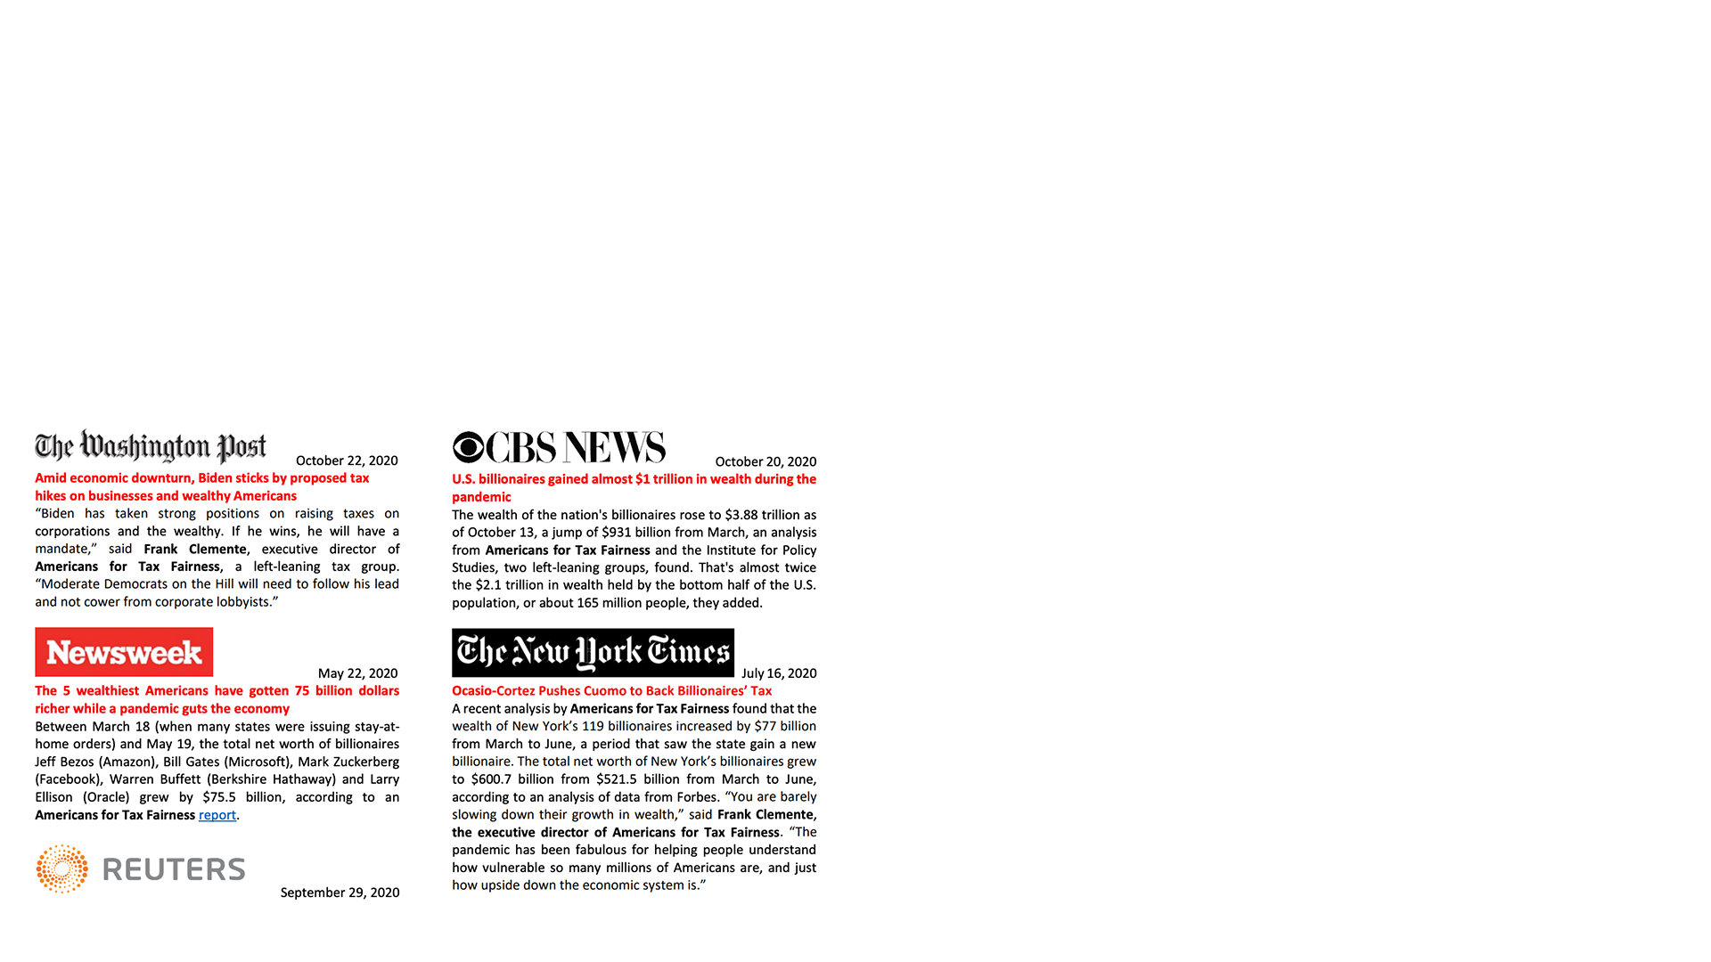
POLLING &
MESSAGING
SPOKESPERSON
1,600-plus media hits in 2020
Tax fairness has become a winning message

Slide 28
SOCIAL MEDIA
EMAIL
Reaches >1 million people a week
on Twitter, Facebook, Instagram
Strong following among influencers
760,000-person list activated weekly
Coordinate joint actions with allies
Total raised 2020: $219,000
(15% of budget)
8,000 grassroots donors from all 50 states

Slide 29
BILLIONAIRES
WEALTH TAX
Our research on billionaires has driven the narrative on pandemic-era inequality.
Our website leading promotion of Sen. Warren’s wealth tax

Slide 30
ATF’S BUDGET

Slide 31
2020 REVENUE
2021 REVENUE GOAL
$1.4M
$3M
501c3 (85%)
501c4 (15%)

Slide 32
ATF REVENUE SOURCES
20%
Major
donors
59%
Foundations
15%
Grassroots
donors
6%
Unions

Slide 33
AMERICANS FOR TAX FAIRNESS CONTACT
Frank Clemente, Executive Director
fclemente@americansfortaxfairness.org
202-441-9818

